Slide 1

Study on overtopping over constant slope dike
Proteus Toolkit
06/21/2019
<number>
Notes:
Simulation of Overtopping over a constant slope dike
<number>

Slide 2
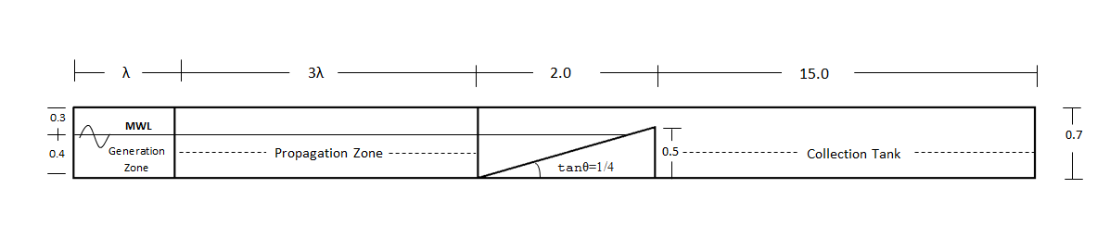
Geometry
Drainage pipe added for 2nd round of simulations
06/21/2019
<number>

Slide 3
Overtopping parameters
Hm0 toe (m) | Tp toe (s)
0.1675 | 2.1547
Rc (m) | Structure’s Slope
0.1 | 1/4
06/21/2019
<number>

Slide 4
Discharge Timeseries
Note the strong decreasing trend in the case without drainage.
Fig. 3. Discharge Timeseries for the initial geometry
Fig. 4. Discharge Timeseries for the new geometry
06/21/2019
<number>

Slide 5
Cumulative Discharge Timeseries
With drainage
06/21/2019
<number>

Slide 6
Comparison to Physical Modelling
Simulated Mean Discharge (m3/s/m) – No drainage | Simulated Mean Discharge (l/s/m) – With drainage | Experimental Mean Discharge from CLASH database (l/s/m) | Best match
3 | 5 | 6 | 16.01%
06/21/2019
<number>
Notes:
<number>
Simulation of Overtopping over a constant slope dike

Slide 7
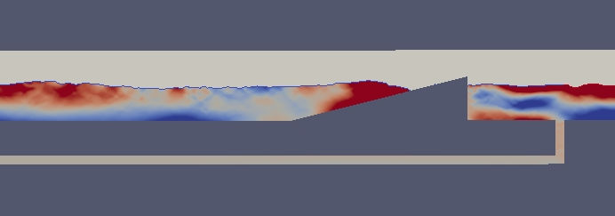
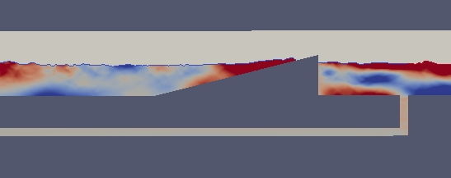
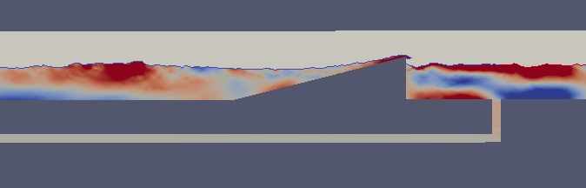
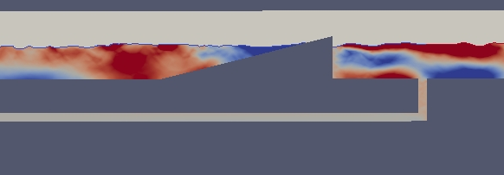
Overtopping event
06/21/2019
Fig. 6. New Geometry
<number>

Slide 8
Overtopping Event
Summary:
Wave are generation takes into account the need for maintaining a non-repeating signal. ~250 waves were run for these simulations.
Results with drainage are improved, as water level at the seaward side is maintained constant
The test case can be considered as a “blind” test against one experiment from the Clash database
Final agreement with experimental data (5 l/s/m against 6 l/m/s) is very good, given the uncertainties associated with overtopping processes
Further tests are planned for validation against random wave results in the CLASH database
Move into new interface and test new solver libraries to improve ease of use and speed.
06/21/2019
<number>

